Slide 1
Final Project Review
Team 1 (AutoUmp)
April 11th, 2017
Notes:
30 minutes for ppt + demo
20 minutes for evaluator Q&A
From eval: “Once hardware is selected, estimate performance including communication cost.”
We know we need to update the block diagr
From email from Hollot:
- Provide copies of your presentation slide deck to evaluators.
- Include a clear list of your CDR deliverables.
- Practice your prototype demo, as well as the presentation.
\\\
CDR structure: CDR is comprised of team presentation and prototype demo, evaluator Q&A, and evaluator huddle.
a) Team presentation and prototype demo (< 30 min)
* presentation < 10 min
* presentation and prototype demo may take place in different locations; conference room, SDP lab, other.
* evaluators are silent except for clarifications.
* adviser is silent.
b) Evaluator Q&A’s (< 20 min)
c) Evaluator huddle (after team leaves)
* adviser allowed to briefly comment. Not present thereafter.
* evaluators submit completed CDR evaluation sheets (2 sheets) to course coordinator.
CDR evaluation (see attached sheets. Evaluators will bring a copy of these sheets to CDR): CDR has three evaluated components:
1) Presentation (20%): A power point presentation less than 10min in duration. It contains three parts:
* A succinct overview of the project that demonstrates knowledge of all subsystems, including how they fit together and communicate with each other.
* A brief but complete outline of the upcoming demonstration; i.e., what is working and what is not.
* Clear and reasonable goals for the Final Project Review (FPR). These goals include everything that is needed for a finished, functioning system that meets all its specs.
2) Prototype Demonstration (20%): A demonstration of the functioning prototype. A successful demonstration:
* is professional.
* does not confuse the audience.
* helps the audience understand how the whole system works.
* allows each team member to display an understanding of how his subsystem fits into the integrated system.
* tip: provide a copy of block diagram to all evaluators.
3) Prototype Functionality and Subsystem Integration (60%): A prototype that fully functions:
* all essential subsystems are present and fully integrated with each other.
there is complete, accurate, and appropriate flow of power, data and/or information among all subsystems.
-----------------
From Wolf, a week ago
need to calibrate - look up table for field of view for both cameras
to reduce error
need to create the mount for the sapphire crystals. Also to set up the plate so we can put the cameras/boards in.
watch for distortions resulting from: sapphire being level, camera being tilted
for demo:
show detailed processing: background subtraction
show detailed processing: object detection
for these two, do the ball/pendulum
how do you show the final algorithm? know what the correct answer is, and show that we're finding it?
velcro ball/velcro wall?
Matt: catch and stick
You need to try this out in the space that you'll be demoing in.
For app: show where the ball is? (would need to have both uart and bluetooth set up)
Or can show where the ball is on the computer.
------------------
Is it a brick or does it work? - show data coming out in serial - show denoise, etc. Over serial, at as high a frame rate as possible Would be very nice to show data with actual balls. Video, show swinging ball. Low, left, right, high. Show the bit images. Run them through the algorithm in C, to show we can calculate the correct position. Calibrate, explain the calibration, and use it to obtain accurate reading on your tests. Set of slides that have videos/images that show all this.

Slide 2




The Team
Timothy Adams
CSE
Justin Marple
CSE
Jason Camiel
EE
Matt Barnes
EE
Notes:
- block diagram
- cameras/boards to buy (jason/justin)
- fill in with matlab slides
- put in enclosure (jason)
- android app
- test cases/data collection (jason?)
- cdr deliverables
- timetable
- synchronization figure (barnes' code)
I think the way the matlab code is written and does it's checks- it will never recognize a pitch if the right camera is recording frames earlier than the left camera

Slide 3
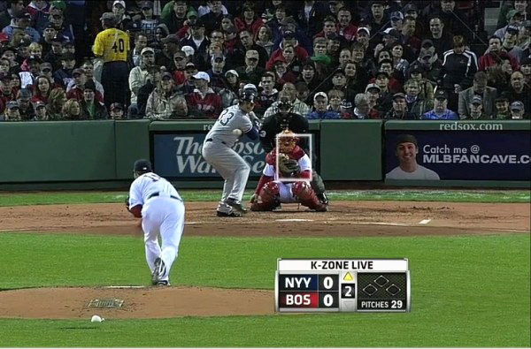
The Setting

Slide 4
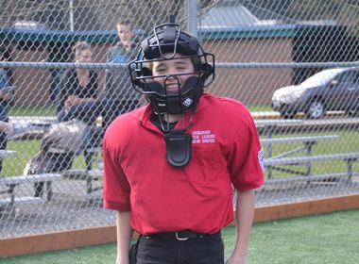
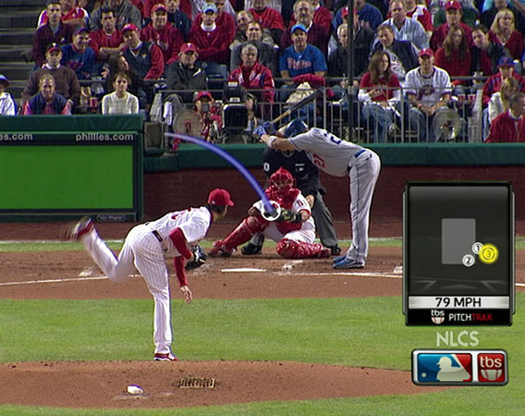
Current Solutions
Prohibitively expensive
Extensive set-up required
Inaccurate
Biased
Notes:
Pitchf/x – most information for cameras high up along first and third base lines.
User manually verifies call from camera in center field

Slide 5
Our Solution
A self-contained, autonomous home plate that detects balls and strikes
Cheaper than traditional technology
Not subject to human error
Notes:
Pitchf/x – most information for cameras high up along first and third base lines.
User manually verifies call from camera in center field

Slide 6
Requirements
Detect balls/strikes accurately (>= human ump)
Detect fastball of average little league player
Real-time use
Self-standing
Battery life lasts duration of game
Robust against physical impacts, changing weather
Allow for different height batters
Notes:
Pitchf/x – most information for cameras high up along first and third base lines.
User manually verifies call from camera in center field

Slide 7
Key Challenges
Detect and track ball with cameras
Embedded hardware
Image processing on an embedded system with power/size constraints
Design of robust, self-enclosed system that still allows for user notification and feedback
Enclosure
App, 2-way communication
Notes:
Pitchf/x – most information for cameras high up along first and third base lines.
User manually verifies call from camera in center field

Slide 8
Block Diagram - Hardware
Notes:
- It may be helpful to show the block diagram before you into a particular component. You can highlight that component on the diagram so that people know what you are talking about.

Slide 9
Specifications
16.7ms throughput for image processing tasks
60fps with 110 degree field of view in flight direction
Maximum 1 second delay
Self-standing
Can withstand physical conditions at baseball field
Battery life > 3 hours
Adjustable height of strike zone from app
Notes:
Draw out specifications, and how they translate to the rest. 60fps, 16.7 ms, field of view, etc.

Slide 10
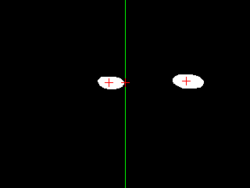
Ball Detection
Interpolate path of ball using a ball on either side of the strike zone
Calculate pixel location of strike zone intersection

Slide 11
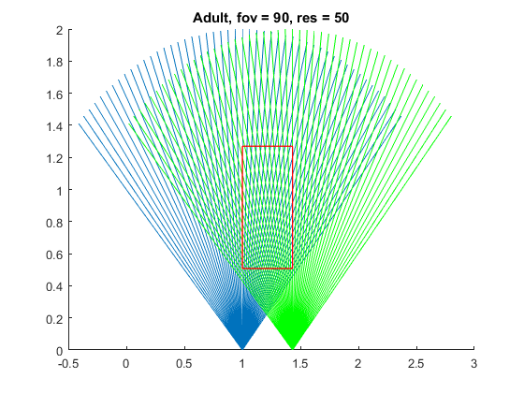
Ball Detection
Use pixel location from each camera to calculate (x,y) position of baseball in strike zone plane
Notes:
Draw out specifications, and how they translate to the rest. 60fps, 16.7 ms, field of view, etc.

Slide 12
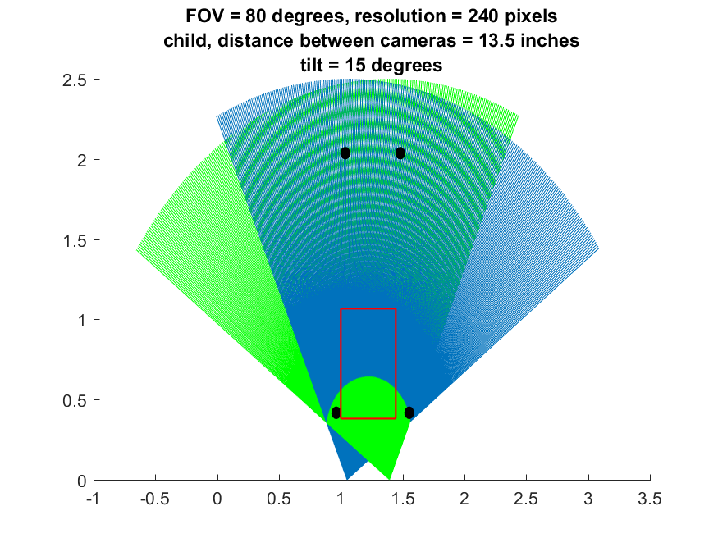
Ball Detection
Tilt cameras in order to see entire strike zone

Slide 13
Dealing with Bottlenecks
Notes:
Draw out specifications, and how they translate to the rest. 60fps, 16.7 ms, field of view, etc.

Slide 14
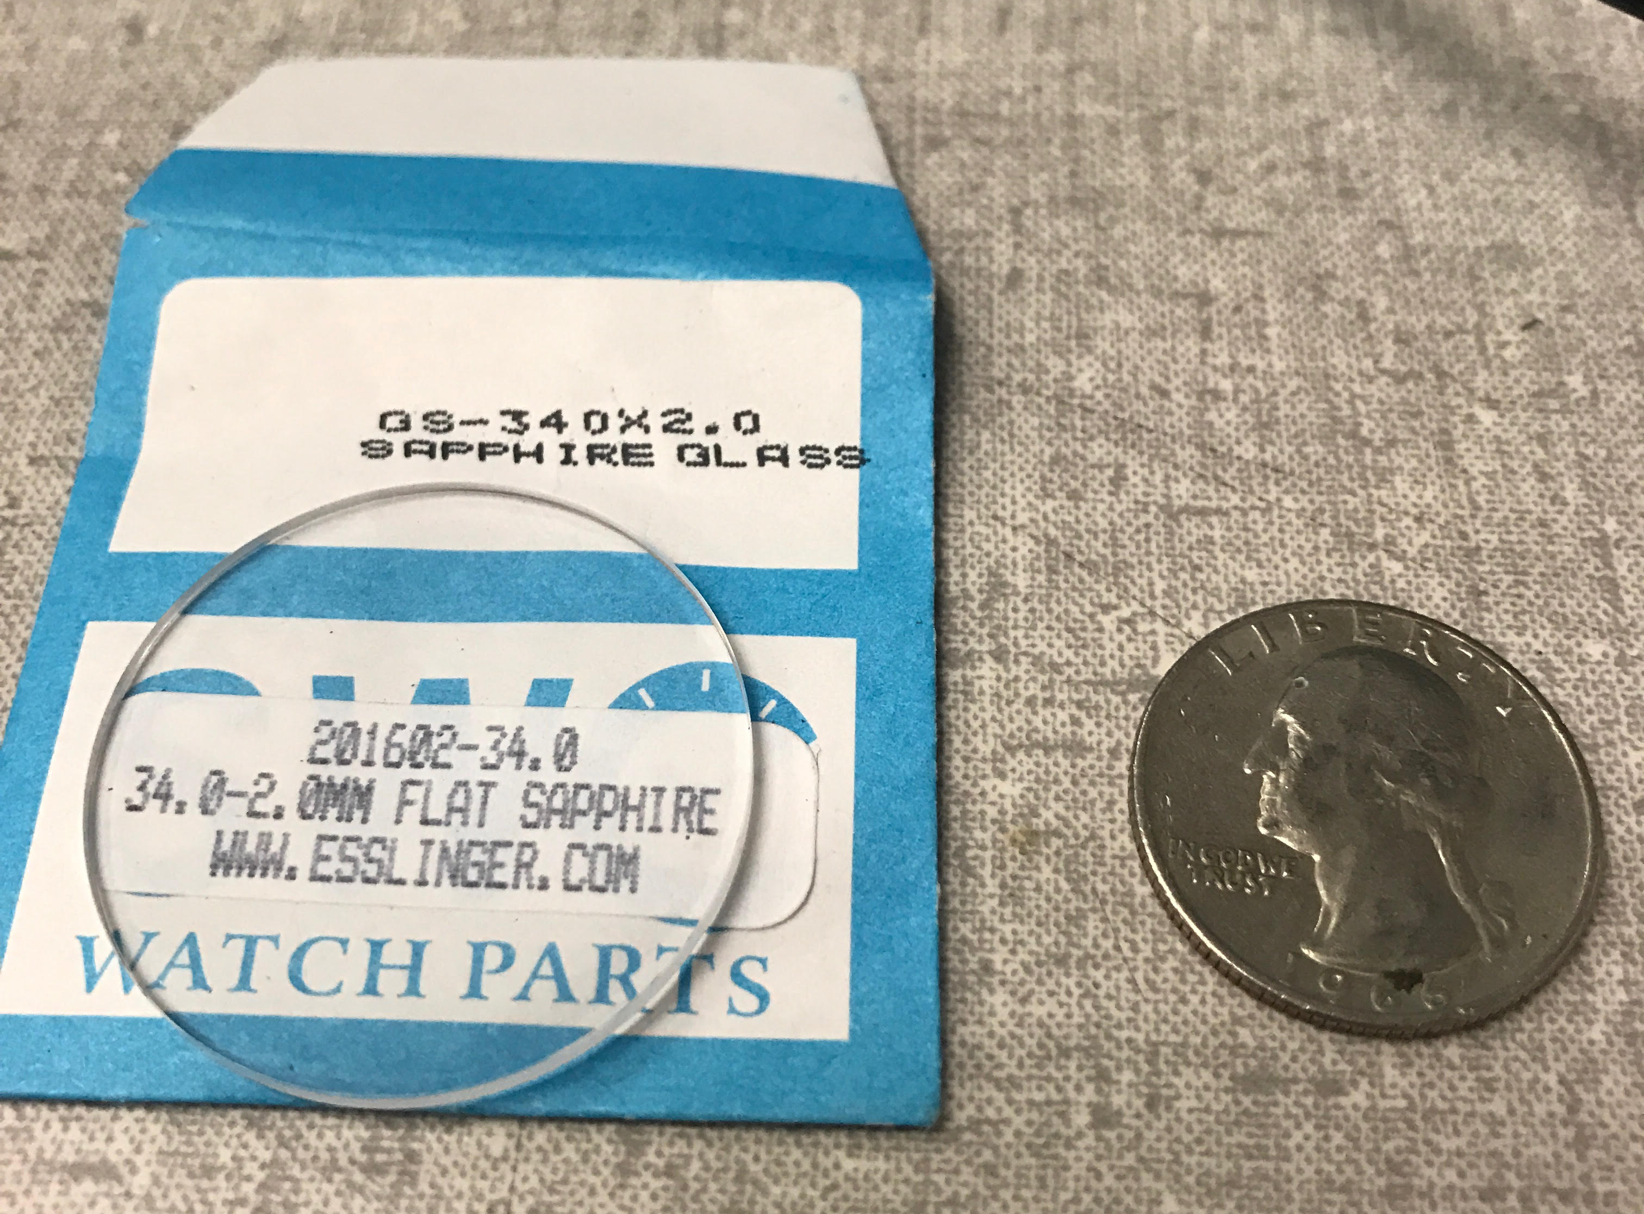
Camera Protection
Baseball fields made up of dirt
Polycarbonate: (Mohs)
Glass: 5.5 (Mohs)
Quartz: 7 (Mohs)
Sapphire: 9 (Mohs)
Notes:
Draw out specifications, and how they translate to the rest. 60fps, 16.7 ms, field of view, etc.

Slide 15
Requirements
Detect balls/strikes accurately Often
Detect fastball of little league player ~35mph
Real-time use Yes, no perceptible delay
Self-standing Yes
Battery life lasts duration of game Yes
Robust against physical impacts, changing Yes weather
Allow for different height batters Yes, via app
Notes:
Cost: two numbers, development (what we spent), and per unit (if you were to build 1000)
Battery life

Slide 16
Costs
Initial Prototype Development: $380.26
Final Prototype Development: $677.25
PCBs: $478.28
Enclosure: $198.97
Miscellaneous: $185.69
Development Cost: $1242.94
Final Prototype Actual Cost: ~$200.00
Notes:
Pitchf/x – most information for cameras high up along first and third base lines.
User manually verifies call from camera in center field

